Slide 1
Stressed out
Joren Janzing

Slide 2
Content
Recap: where were we?
Surface Stress Curl
Mechanisms
1940s and the Relationship with the IPO.

Slide 3
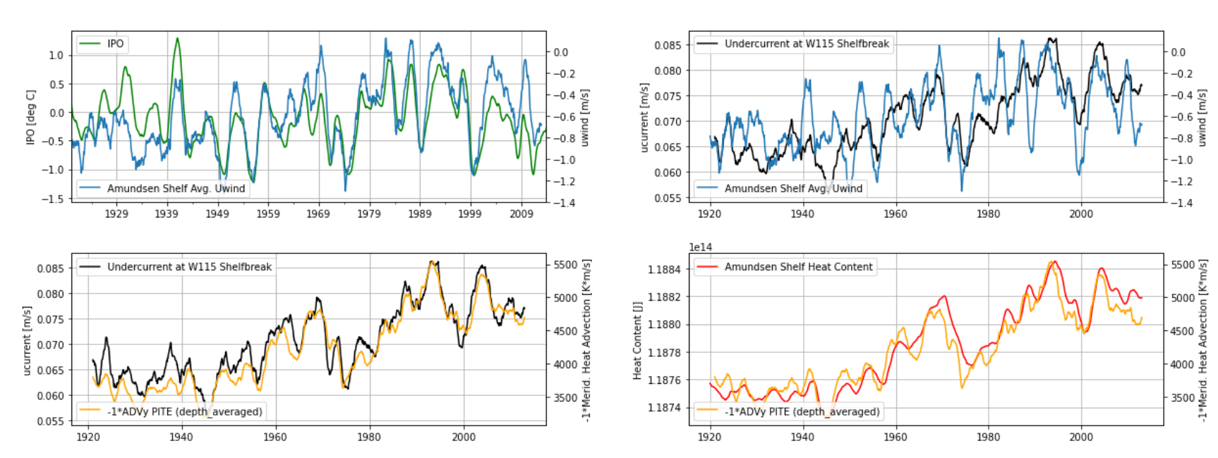
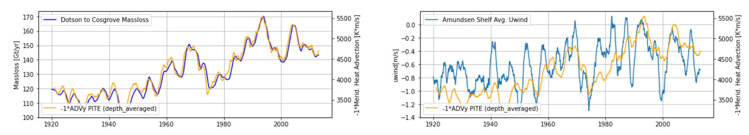
Recap: Ensemble Mean

Slide 4
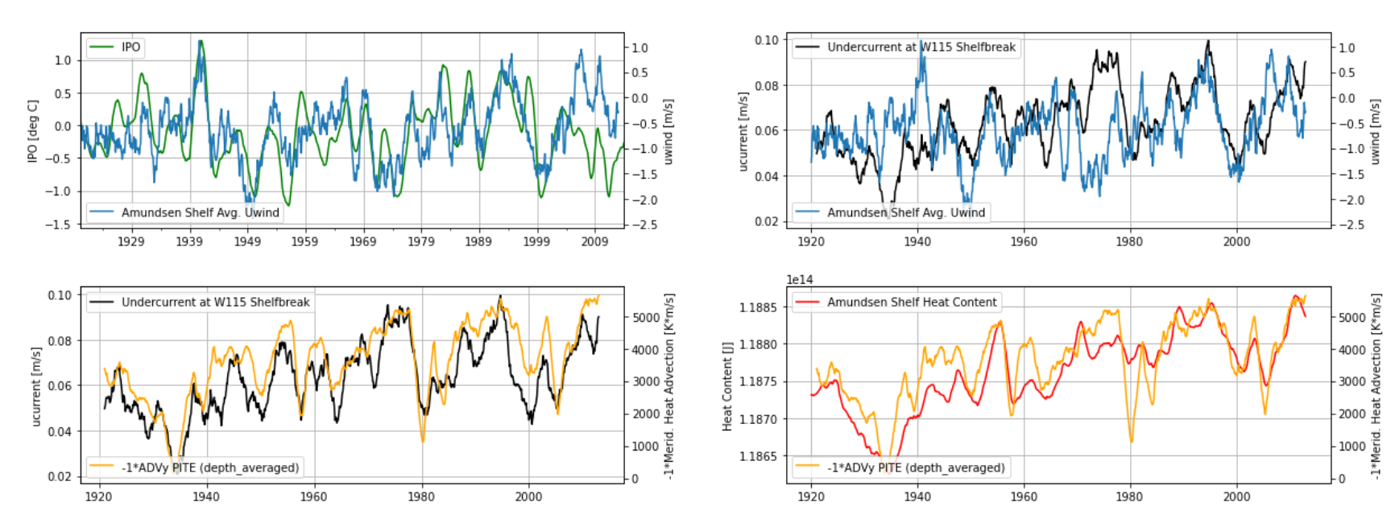
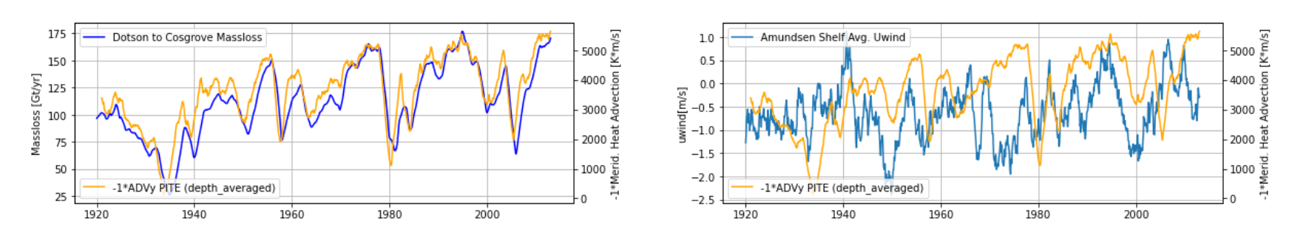

Slide 5
Surface Stress Curl

Slide 6
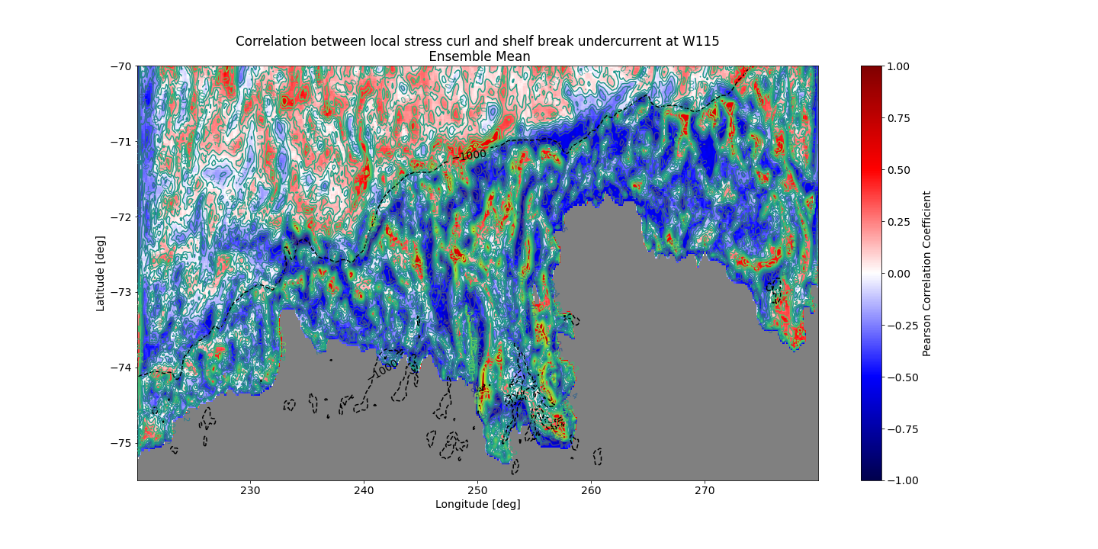

Slide 7
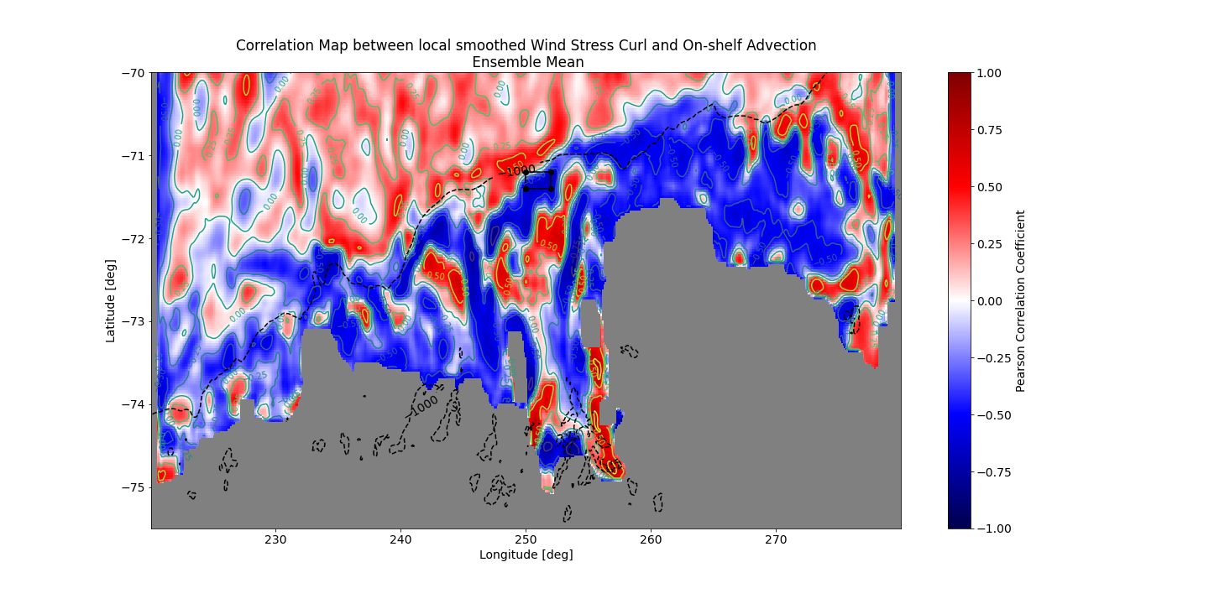

Slide 8
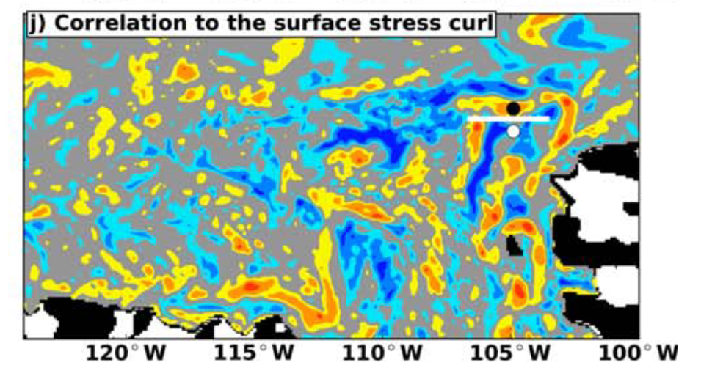
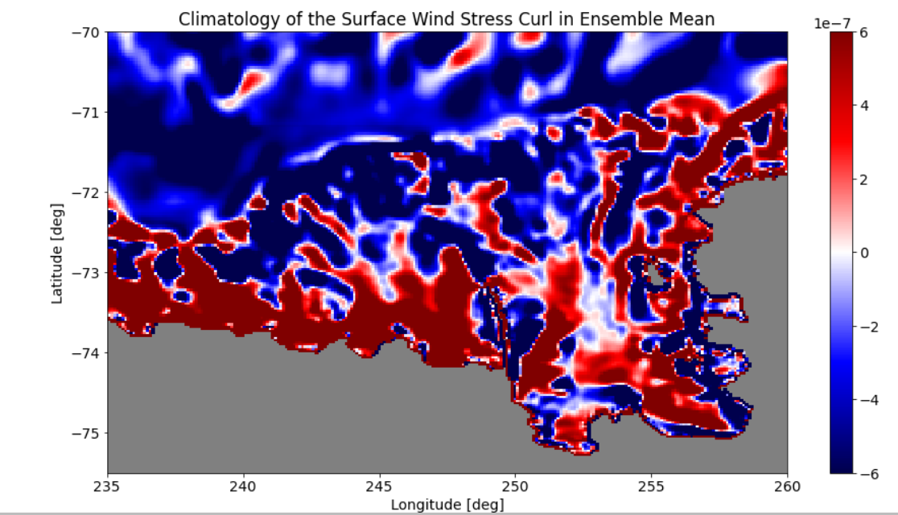
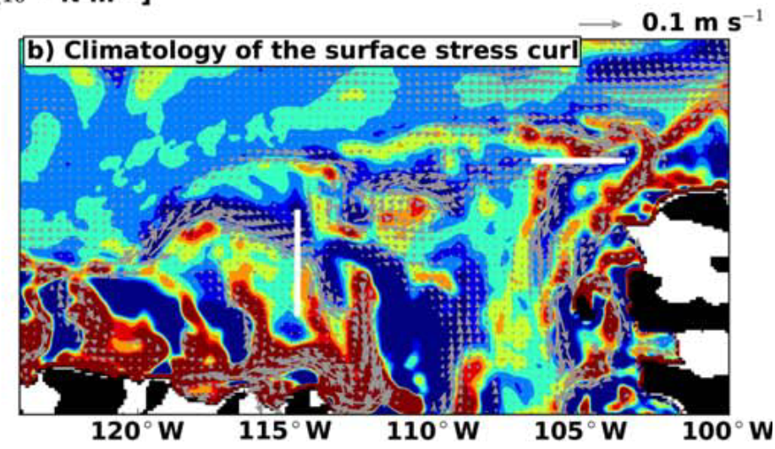
Reinventing the wheel…
Kimura et al., 2017

Slide 9
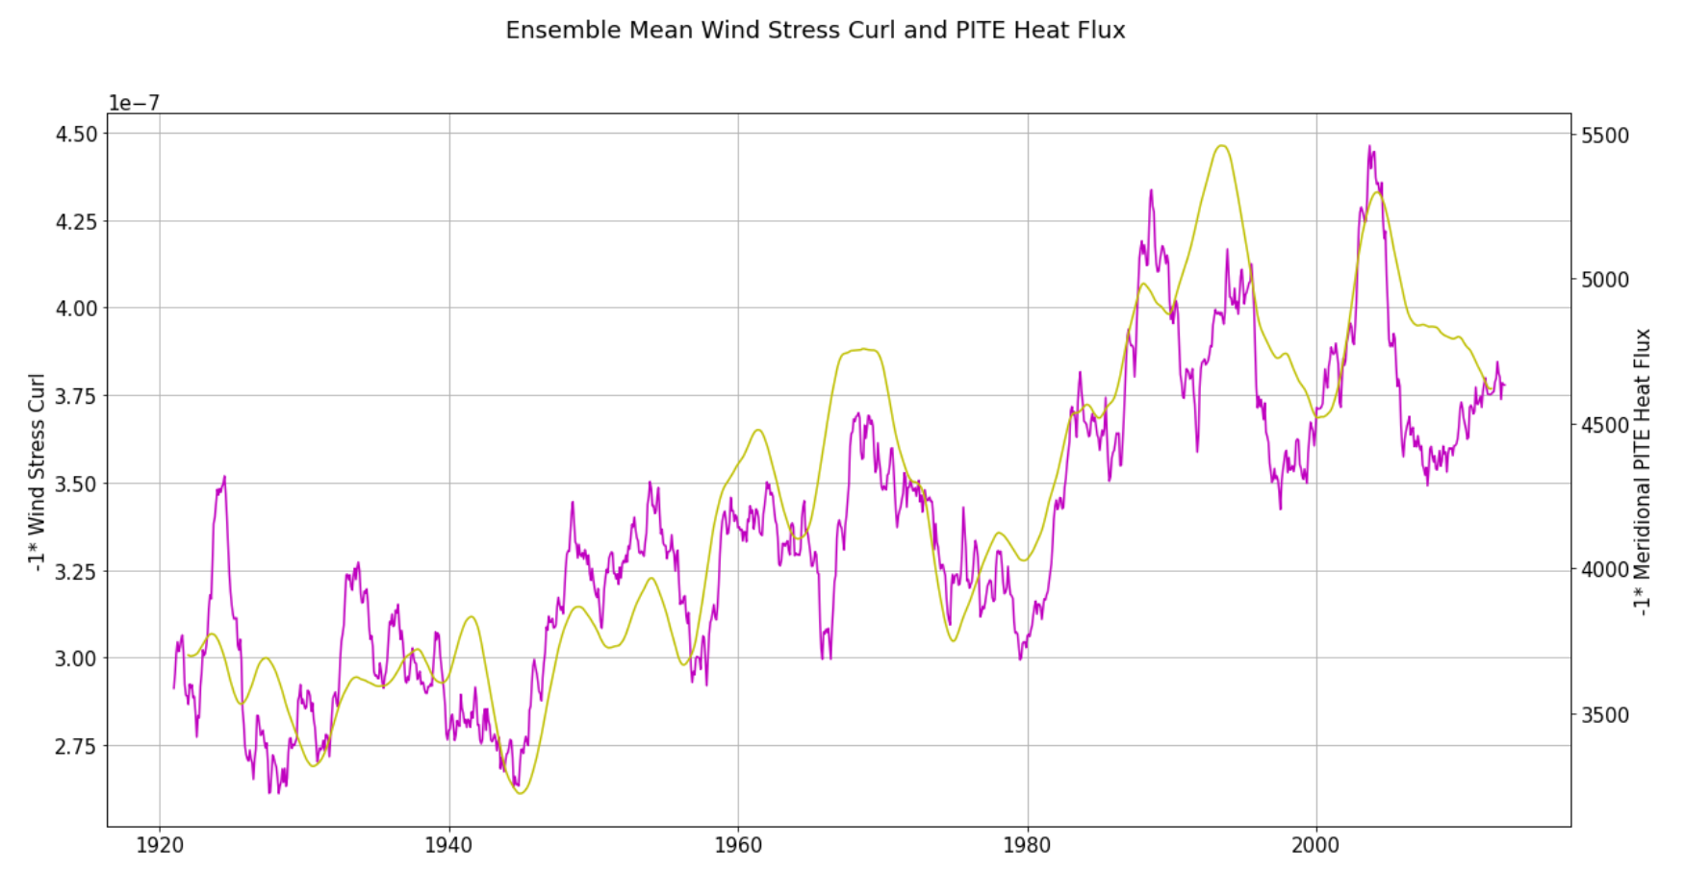

Slide 10
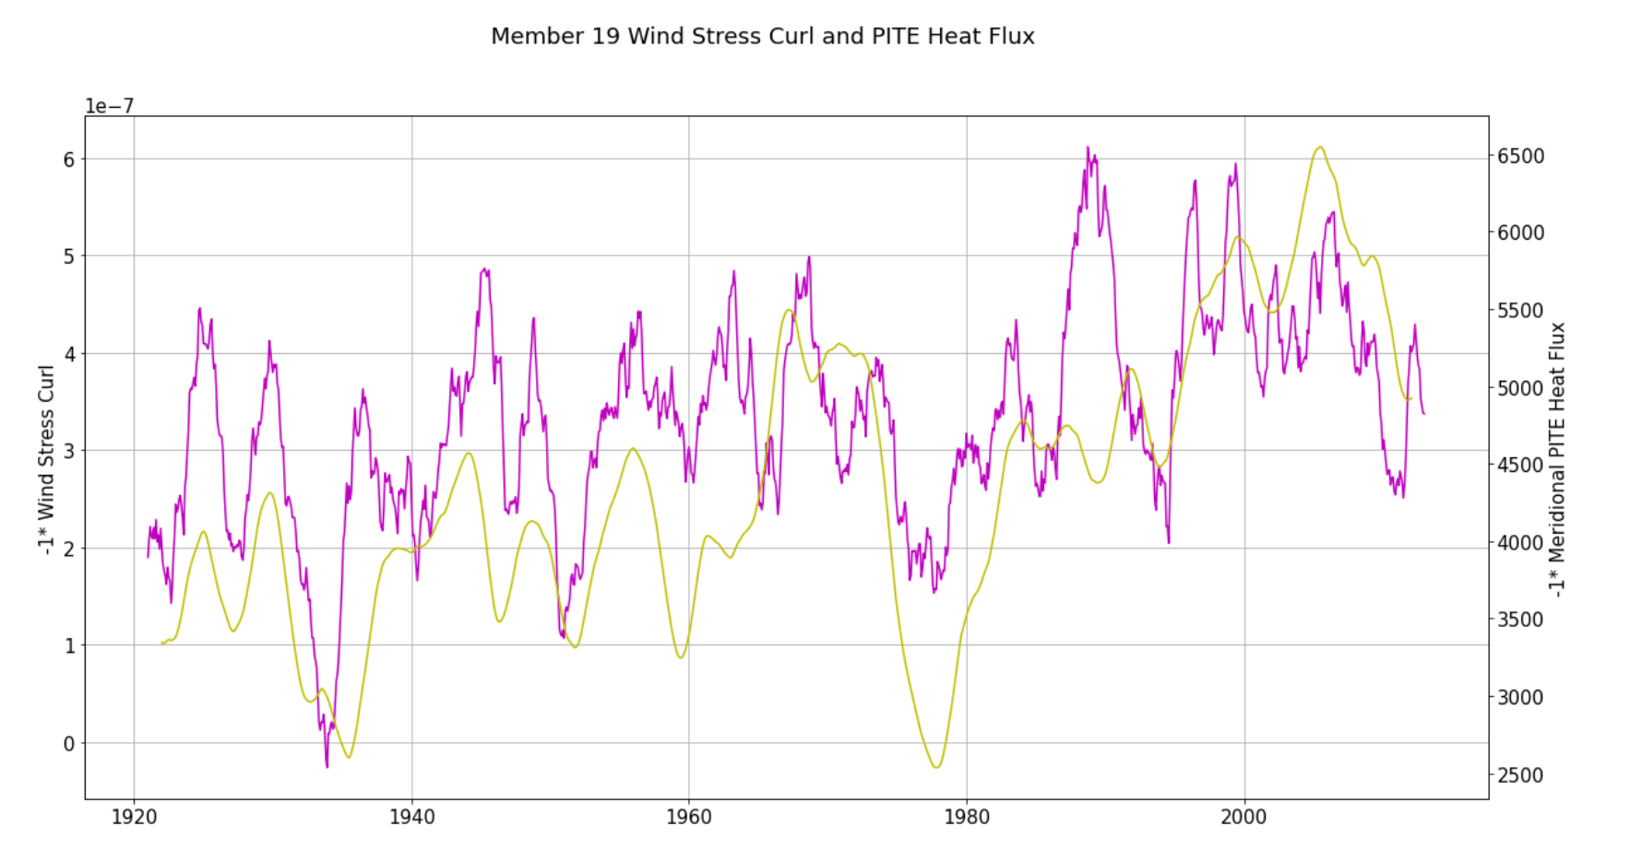

Slide 11
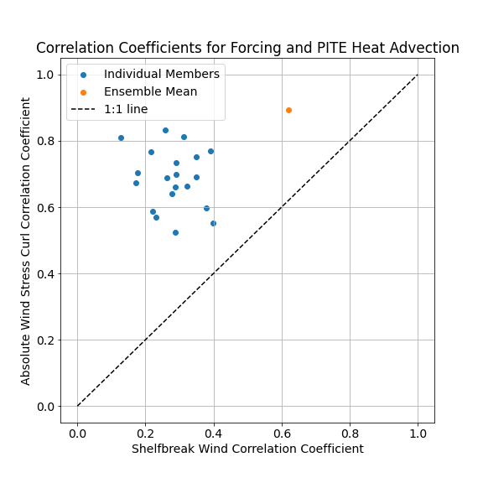
Comparison Wind stress curl with zonal shelf winds

Slide 12
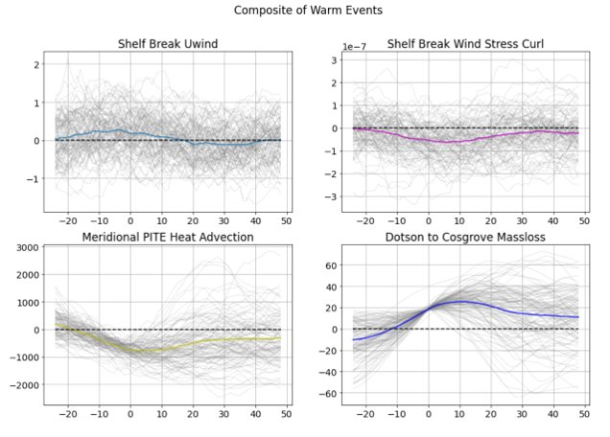

Slide 13
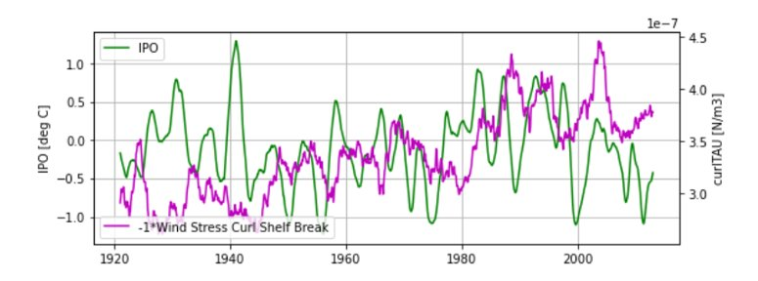

Slide 14
Subconclusion
Surface Stress Curl seems to be a better predictor of heat advection (and melt!) than zonal wind.
Both for Ensemble Mean and Individual Members
Downsides…:
Wind stress curl spatially very variable, less predictable?
Less control of the tropical variability on the wind stress curl than on zonal wind?

Slide 15
Mechanisms

Slide 16
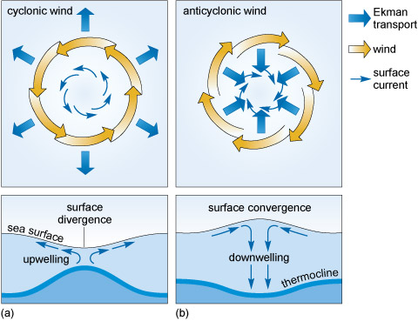
Mechanism
Option 1: negative curl on shelf
→divergence of water
→upwelling (of warm water?)
→shallowing of thermocline
→weaker gradient
A: →change in flow (weaker??)
B: →shif in location of flow?
Option 2:
negative curl on shelf
→divergence of water
→lower SSH → stronger gradient.
→effect on barotropic flow?

Slide 17
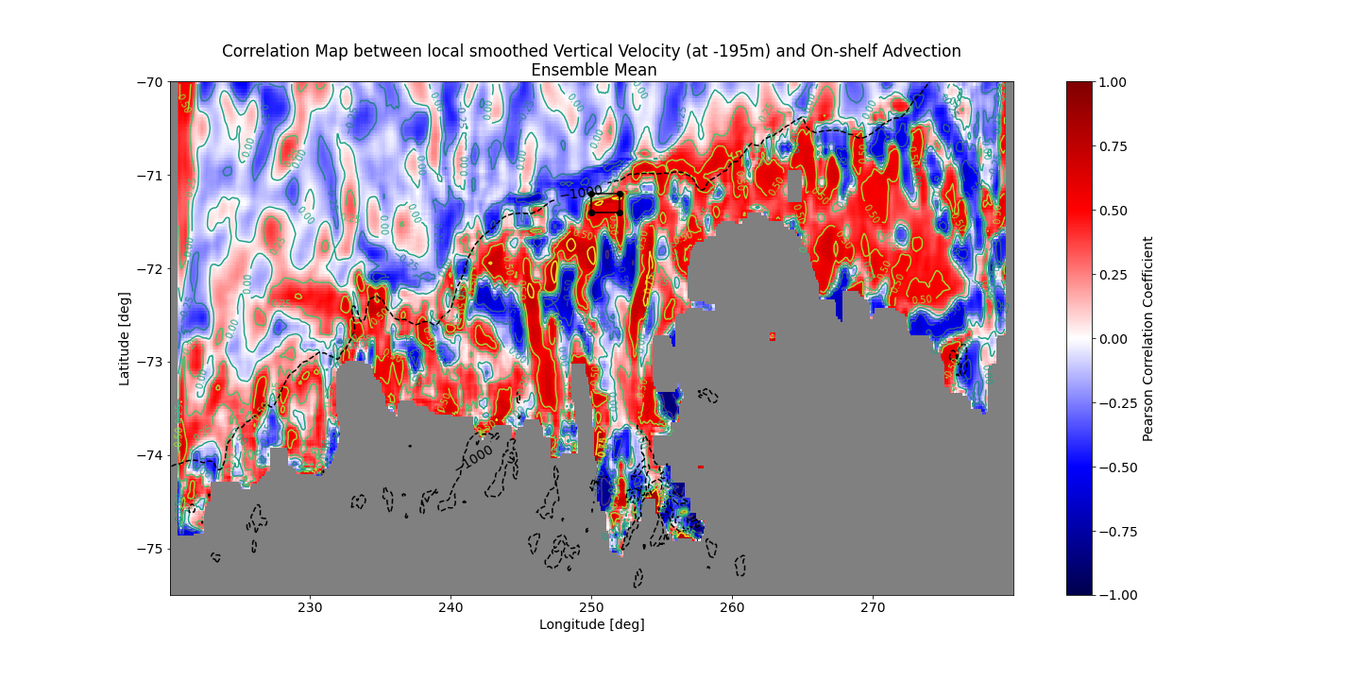
Option 1: Ekman Pumping
Vertical Velocity and curlTAU

Slide 18
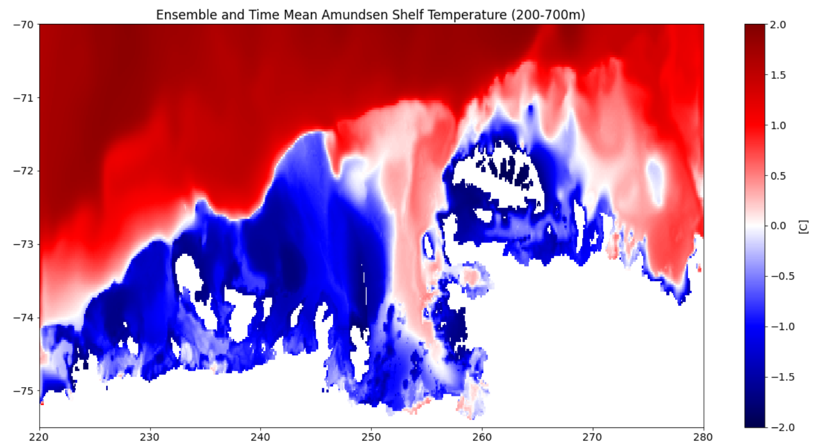
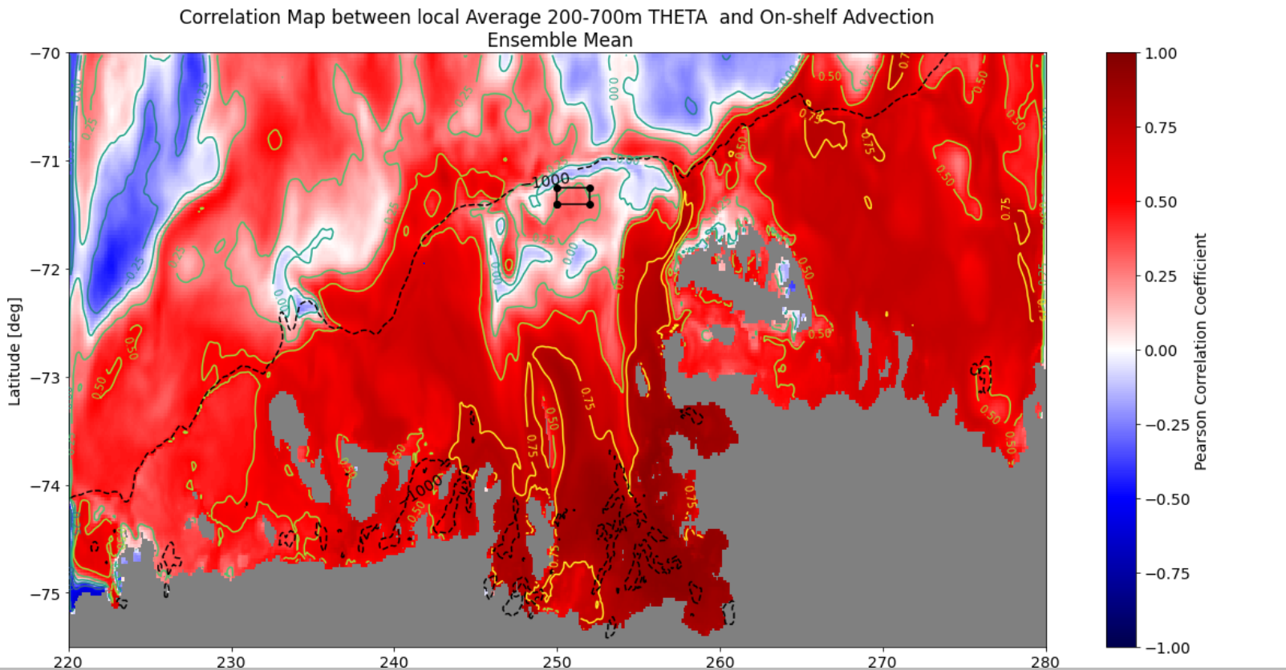
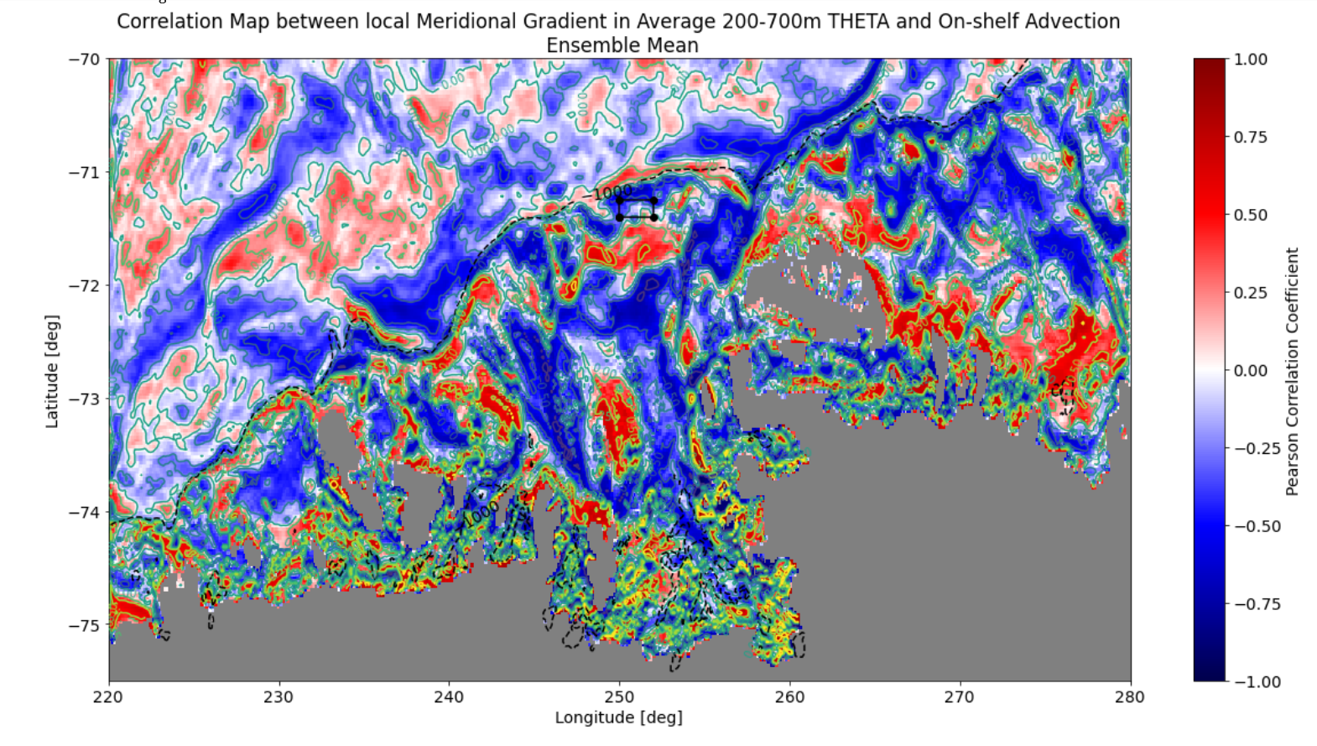
Mean Temperature (btwn 200-700m)
~ Thermocline
* Stronger shelf break gradient during strong on shelf advection? (opposite to what expected?)
* Or further from the shelf edge? * Baroclinic effect?

Slide 19
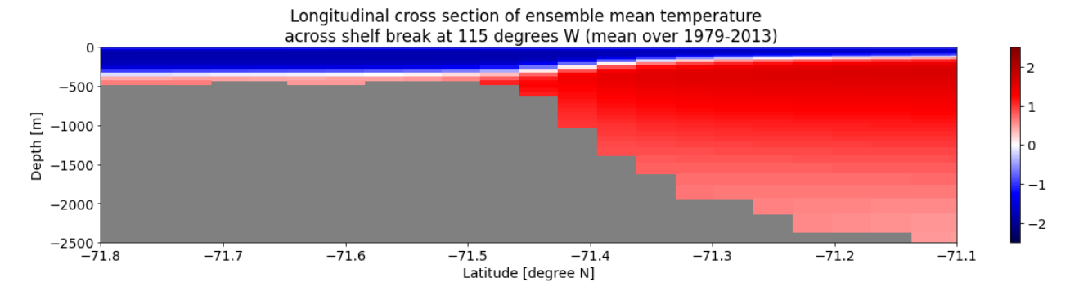
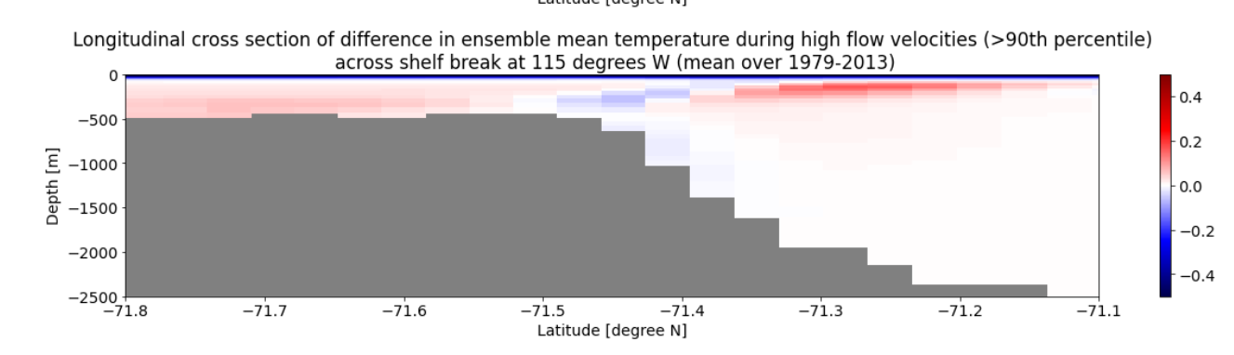
Mechanism: negative curl on shelf→ upwelling? → +/- temperature gradient → increased flow?
[C]
[C]

Slide 20
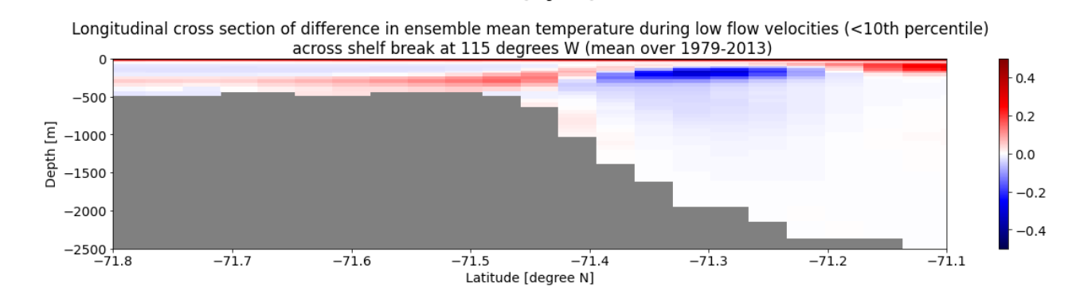

Slide 21
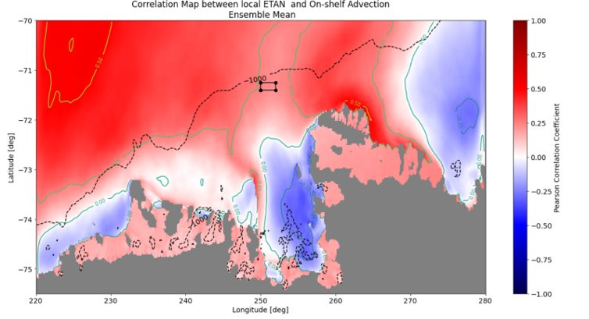
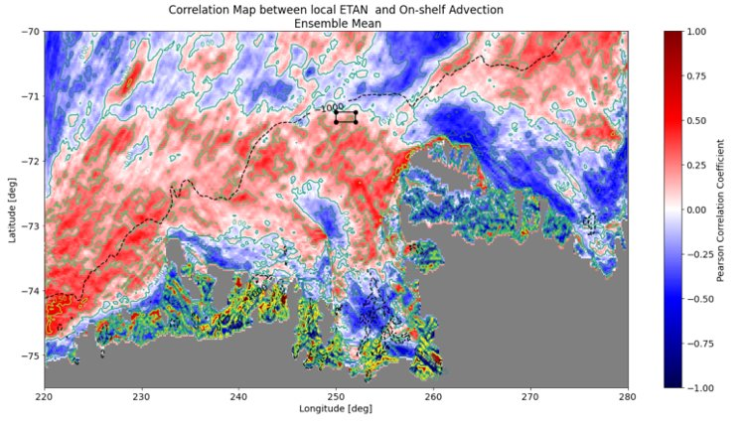
Meridional Gradient
Ensemble Mean
Option 2: Sea Surface Height (ETAN)
* Not really a strong shekf break effect it seems

Slide 22
Subconclusion
Surface Stress Curl affects the vertical velocity as expected.
Meridional Temperature Gradient accross shelf break seems to be stronger during periods of strong heat advection. → Opposite of what I expected with the upwelling regime? → Would lead to a baroclinic effect.
SSH: Not really a clear shelf break effect.
Other options?

Slide 23
The 1940s and the Relationship with the IPO

Slide 25
The 1940s: Why is there no peak?
Hypotheses:
1. Although the wind shows it, the sea ice stress masks this effect.
2. Although the zonal velocity shows it, the meridional velocity does not.
3. It is just a difference in the spatial pattern.

Slide 26
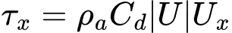
Option 1: It is in the sea ice stress
For this, we are calculating the wind stress directly based on wind.
Assuming that the difference is caused by sea ice.
Rho_a=1.225 kg/m^3
C_{D} ≈ 1.25 × 10⁻³
(E.g. Kara, A. Birol, Alan J. Wallcraft, E. Joseph Metzger, Harley E. Hurlburt, and Chris W. Fairall. "Wind stress drag coefficient over the global ocean." Journal of climate 20, no. 23 (2007): 5856-5864.)

Slide 27
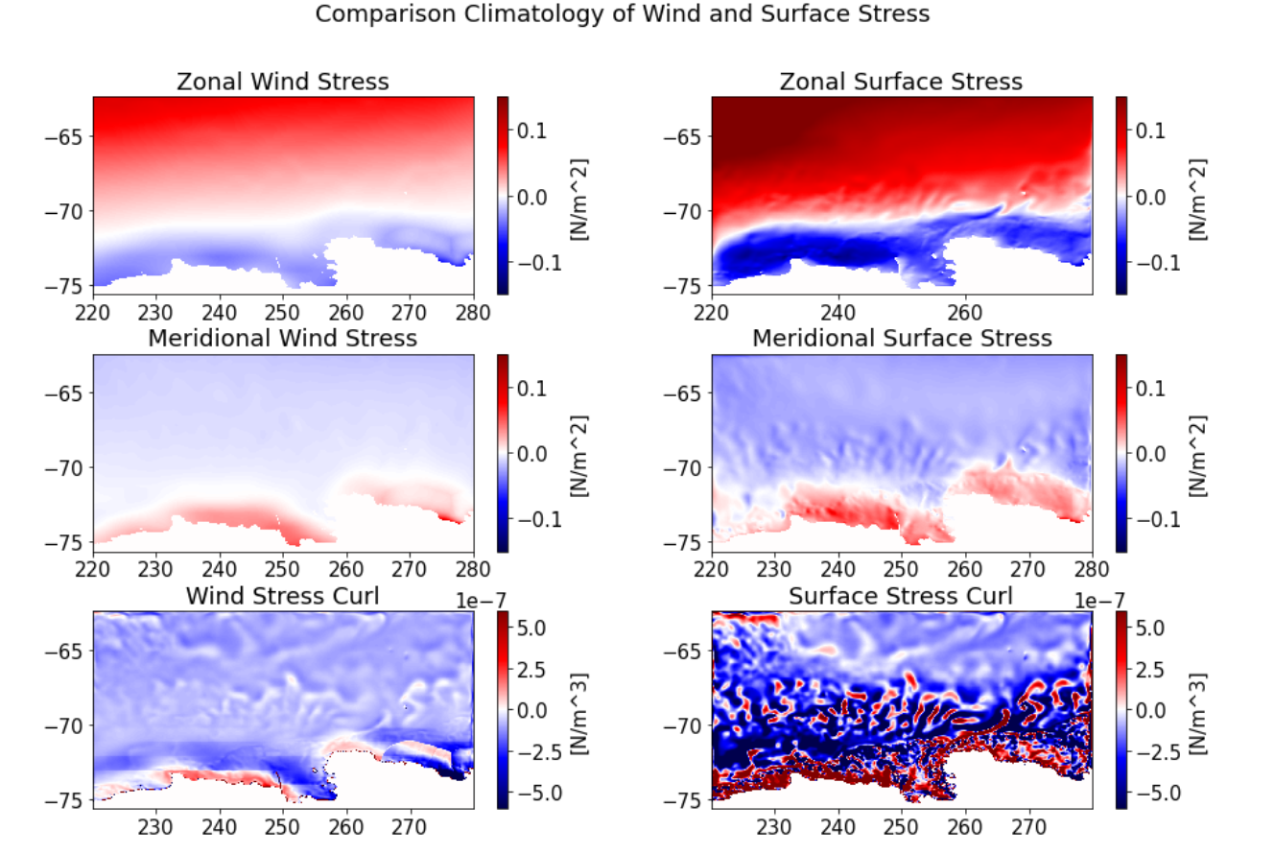
Wind Stress and Surface Stress:
Disclaimer, wind stress curl looks... well, not great.
Features are present though.

Slide 28
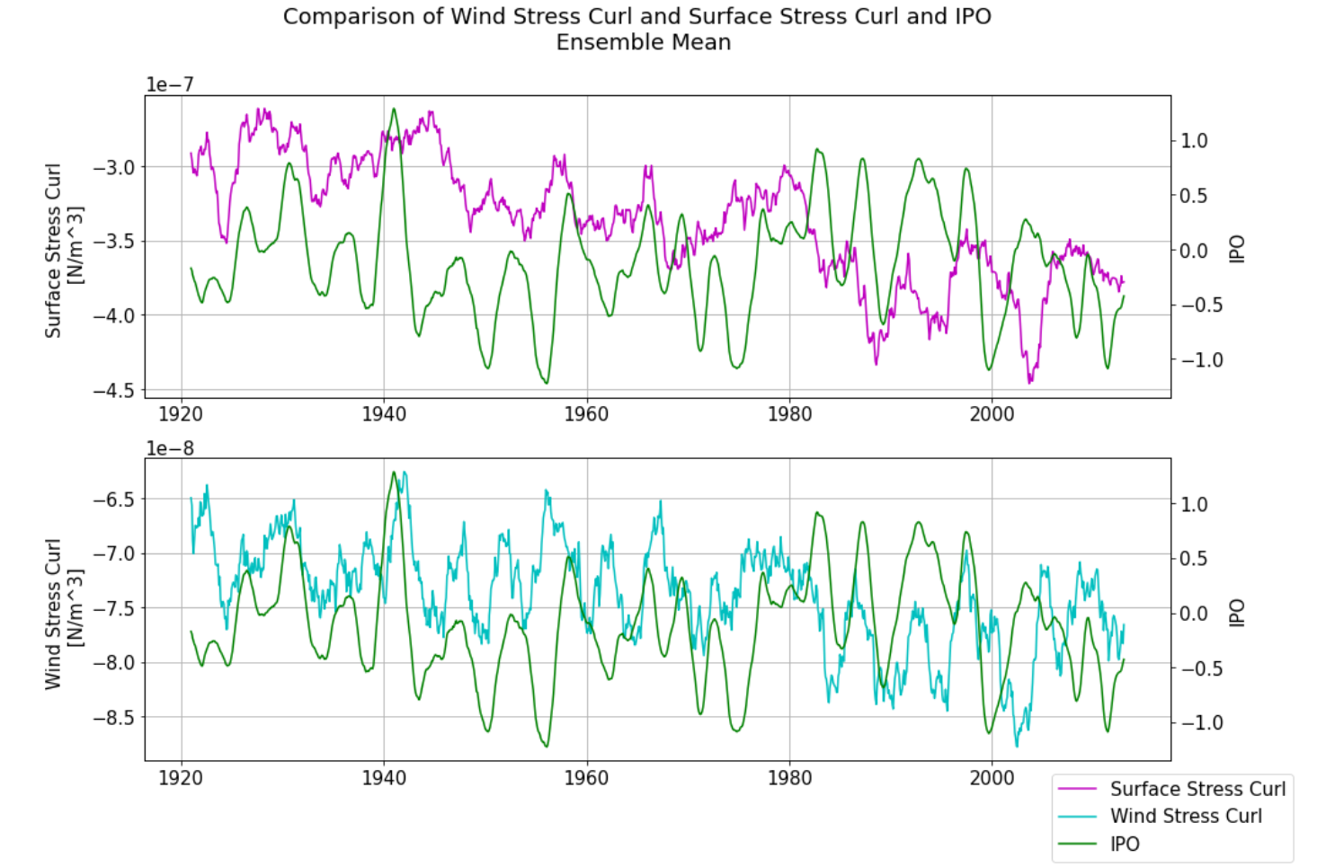
Wind Stress and IPO:
1940s is present in with stress curl, much less so in surface stress curl.
Wind Stress Curl sometimes positive Correlation with IPO (with lag?) --> Negative Correlation with Melt and Heat (Alessandro!)?

Slide 29
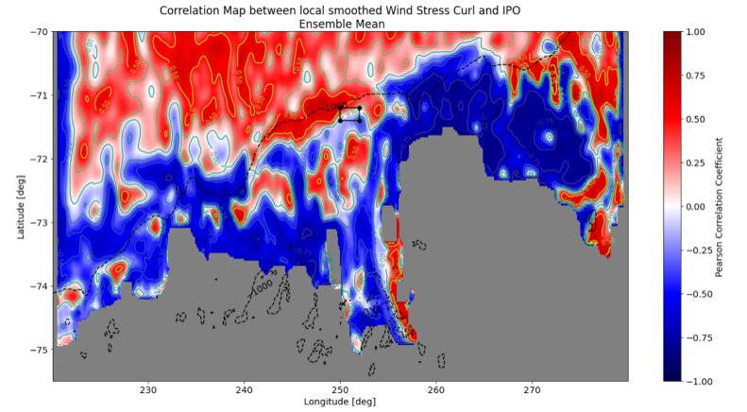
What is the effect of the IPO on Surface Stress Curl?
Virtually identical patterns as with melt, only possibly more focus on the east during ENSO events
More focus on shelf break during melt.
Would suggest positive correlation between IPO and melt.

Slide 30
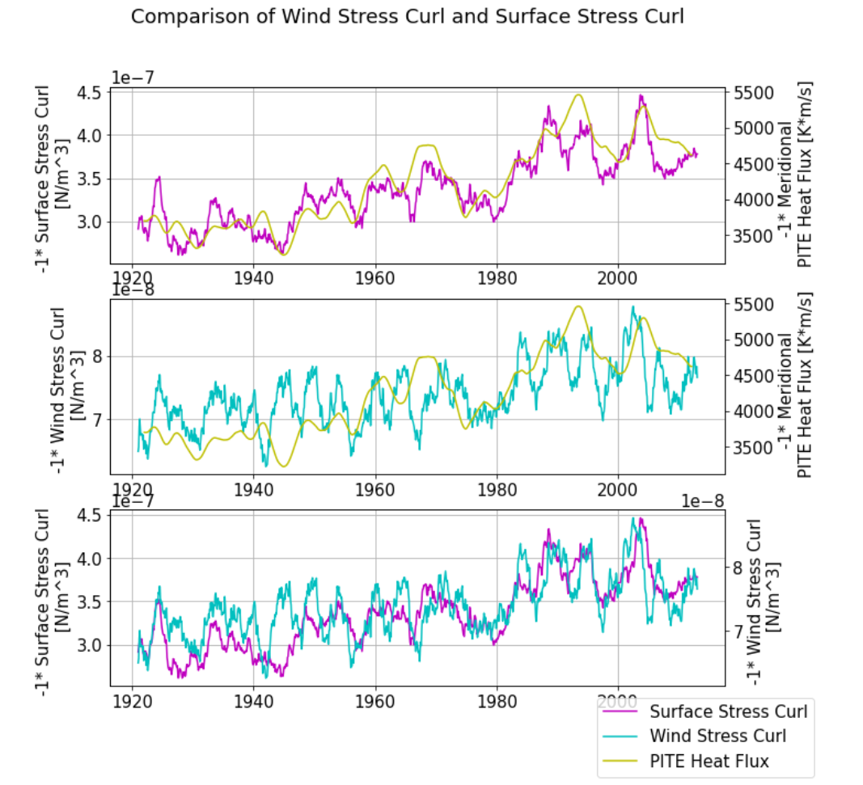
Wind Stress and PITE HEAT Flux:
Wind stress curl and surface stress curl have a negative correlation with melt
Negative IPO affects positive melt!
Sea ice could be one of the reasons that the 1940s effect is smaller.

Slide 31
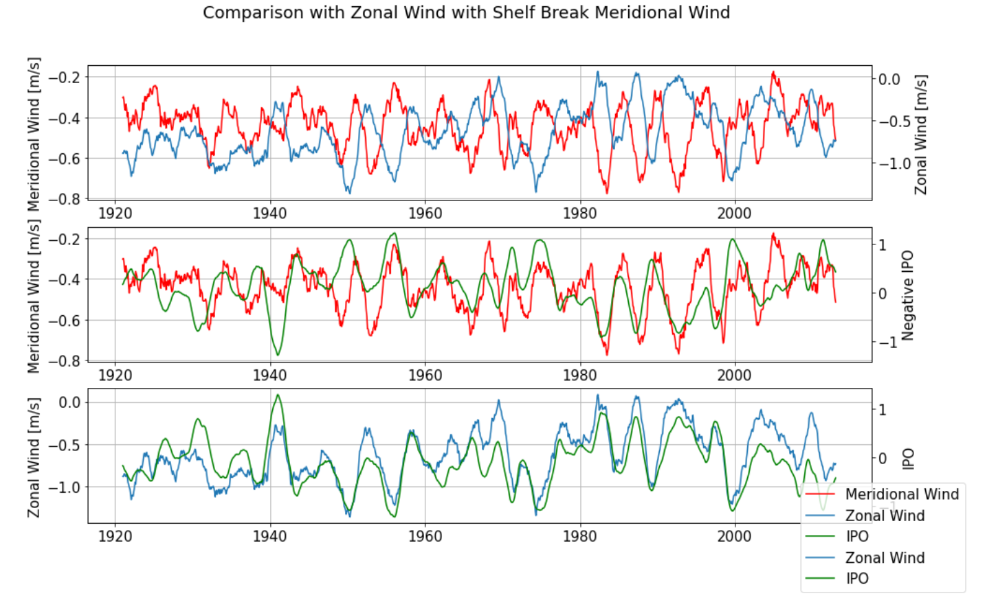
Option 2: Meridional Velocity does not show the event.
Weak anomaly in the meridional wind:
this affects the wind stress (tau ~ |U|), which is less anomalous than expected.

Slide 32
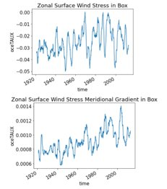
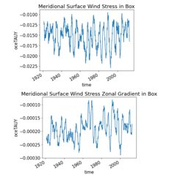
But…. Zonal Surface Stress Shows it, gradient dwarfs meridional stress zonal gradient

Slide 33
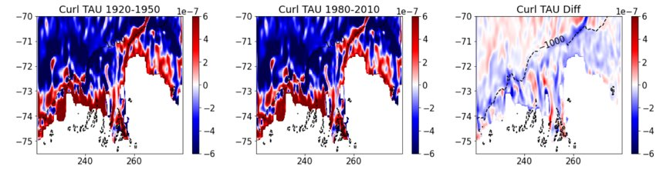
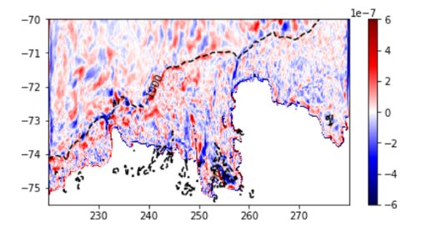
Surface Curl in 1940-1941 with respect to mean ENSO event

Slide 34
Subconclusion
1940s effect not in ensemble mean surface stress curl.
It is possibly present in the ensemble mean wind stress, but negative? → the present of sea ice might partly explain why there is not a strong ENSO effect? → maybe negative effect? → could support Alessandro’s conclusion?
Maybe different spatial pattern?

Slide 35
Conclusion
Surface Stress Curl seems to be the missing link.

Slide 37
Trend

Slide 41
Some conclusions
“surf. wind stress” → but maybe also sea ice?
Wind stress curl spatially very variable, less predictable?
Less control of the tropical variability on the wind stress curl than on zonal wind?
PITE wind box maybe too large
1940s not strong in mean stress curl → no strong response!
Alessandro?

Slide 42
What to add next
High melt and low melt events: - correlation map with melt - composite with time series - composite animation?
Barotropic baroclinic. How does wind stress curl relate to wind? Why is ENSO response so weak in 1940s?
When do we get convection?

Slide 43
Proposed Mechanisms
Zonal Wind Stress (and curl)
Option 1:
‘As simple as that’
Undercurrent
Glacial Melt
Heat Advection on Shelf

Slide 44
Proposed Mechanisms
Air temperature, radiation
Zonal Wind Stress (and curl)
Option 2:
‘It’s complicated…’
Sea Ice
Density (T, S)
Undercurrent
Glacial Melt
Heat Advection on Shelf
Switching between baroclinic and barotropic effect?

Slide 45
Evidence for Option 1

Slide 46
